Slide 1








HOTEL RECOMMENDATION
DSCO FINAL

Slide 2





Our Team
Steve Marcello Liem
Brandon Ritchie Yang
Davin Edbert Santoso Halim

Slide 3




Problem Understanding
Problem:
Hard to find the best hotel according to someone’s needs and preferences on a vacation
Goal:
Hotel Recommendation System

Slide 4

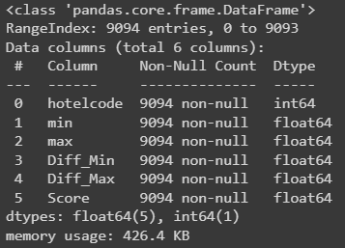
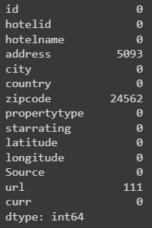
Data Understanding
Hotel_details (NULL Values)
hotel_price_min_max - Formula

Slide 5
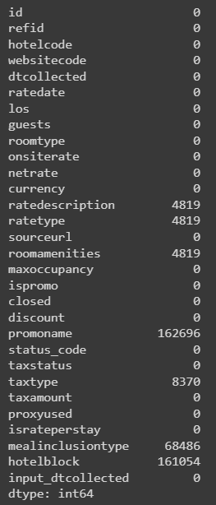
Data Understanding
hotel_RoomPrice (NULL Values)

Slide 6
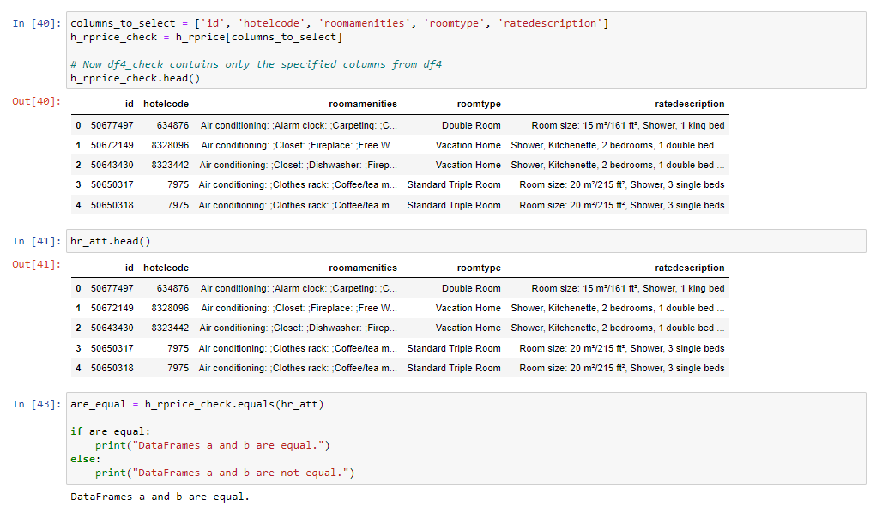
Data Understanding

Slide 7
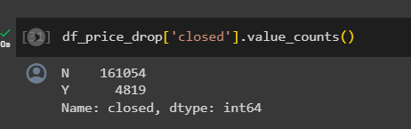
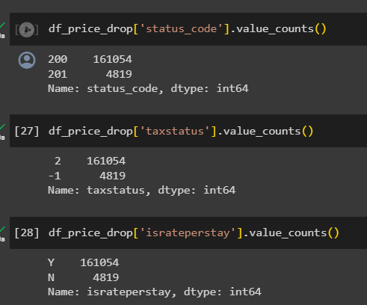
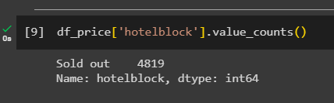
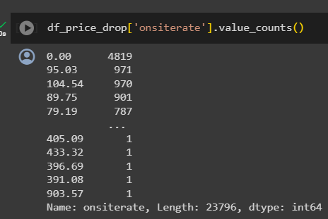
Data Understanding
hotel_RoomPrice Hypothesis

Slide 8
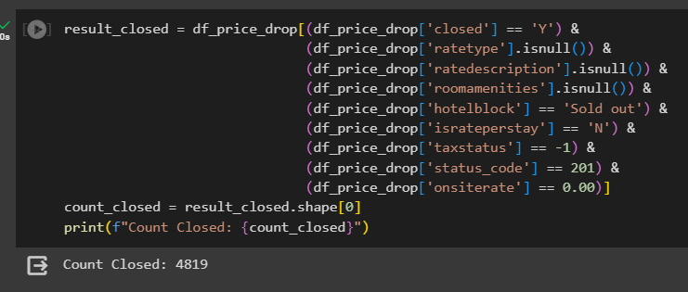
Data Understanding
hotel_RoomPrice
Output

Slide 9

Data Preprocessing
hotel_price_min_max - Formula
hotel_RoomPrice
hotel_RoomPrice
Drop
Diff_Min
Diff_Max
Score
Drop
id
refid
websitecode
los
guests
currency
dtcollected
input_dtcollected
ratedate
sourceurl
proxyused
taxamount
hotelblock
Drop
id
zipcode
latitude
longitude
Source
url
Drop Null
roomtype
roomamenities
ratedescription
Impute Null
promoname -> ‘none’
mealinclusiontype -> ‘no meal’
taxtype -> ‘none’

Slide 10
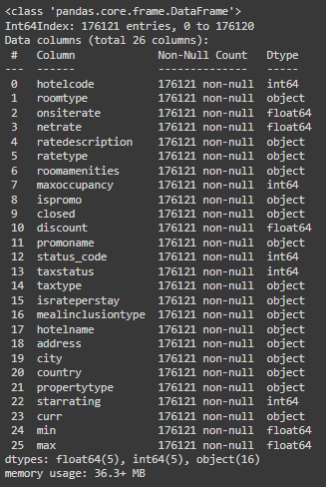
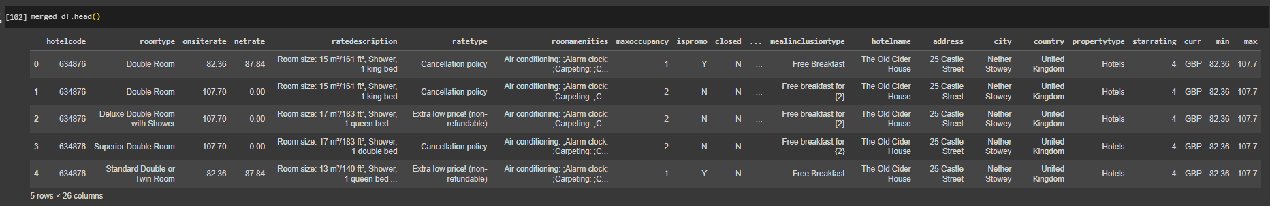
Data Preprocessing
merged_df

Slide 11
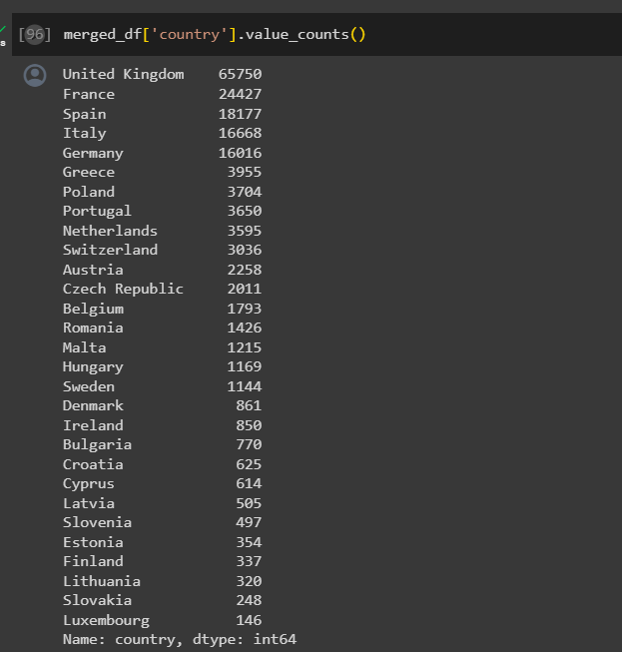
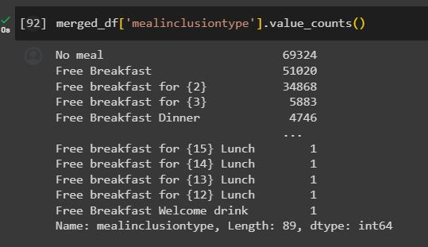
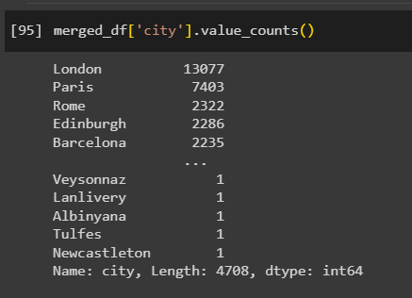
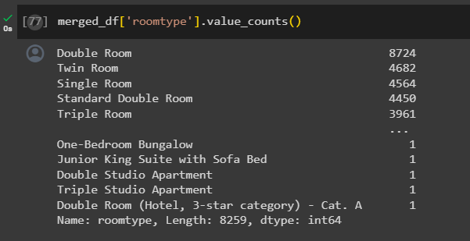
E
D
A

Slide 12
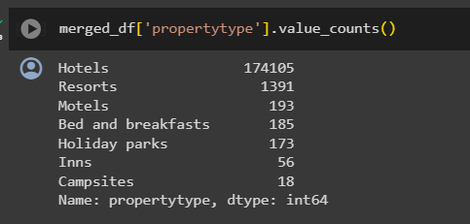
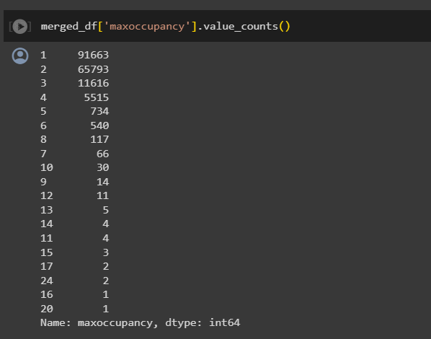
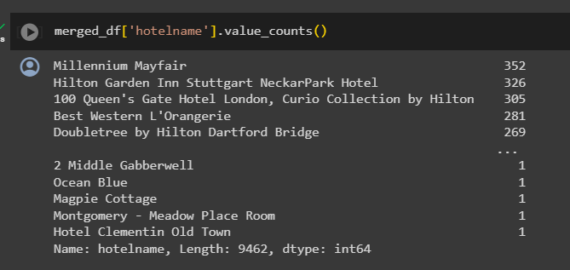
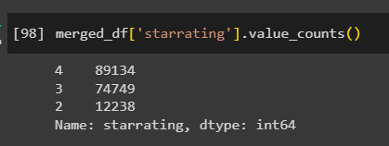
EDA

Slide 13
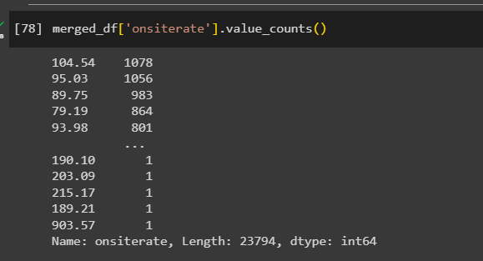
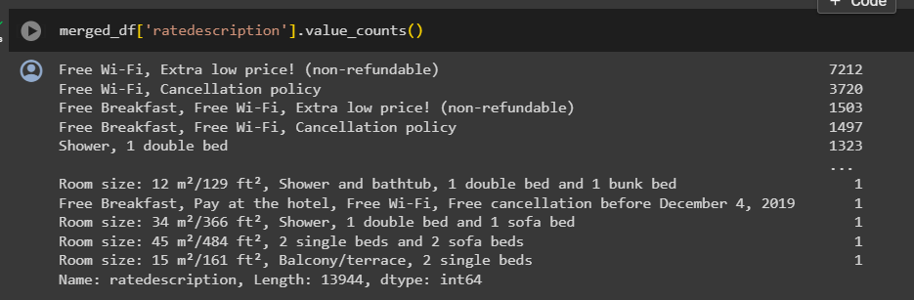
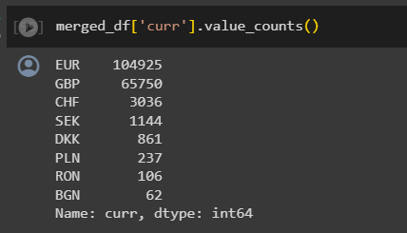
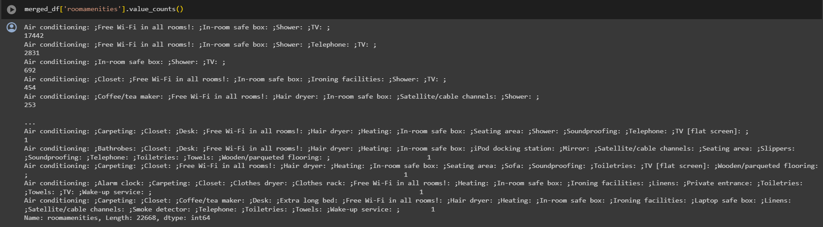
EDA

Slide 14
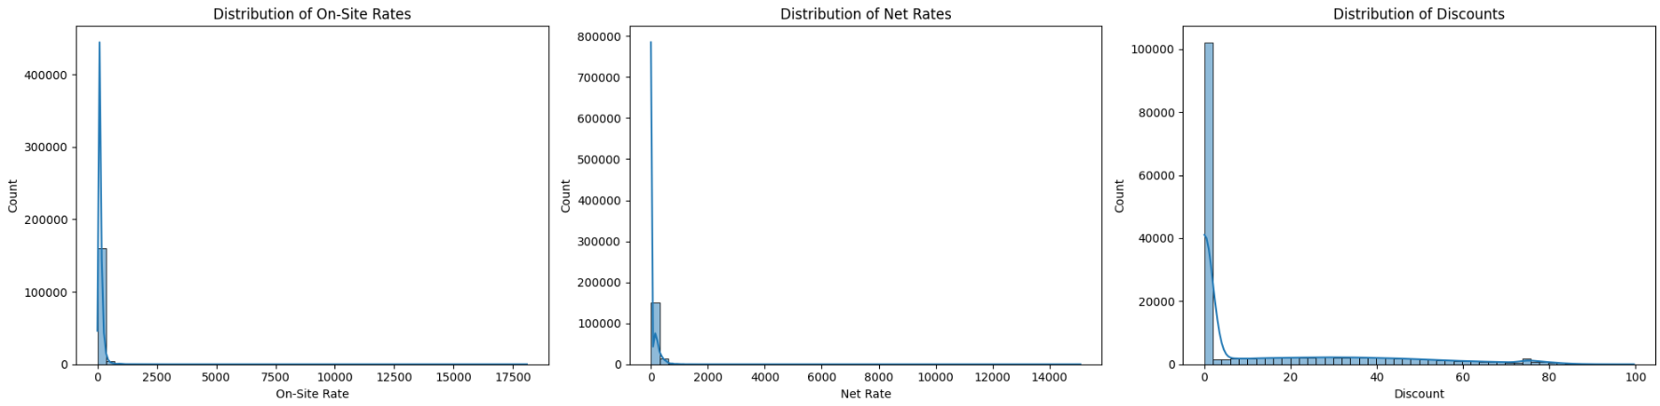
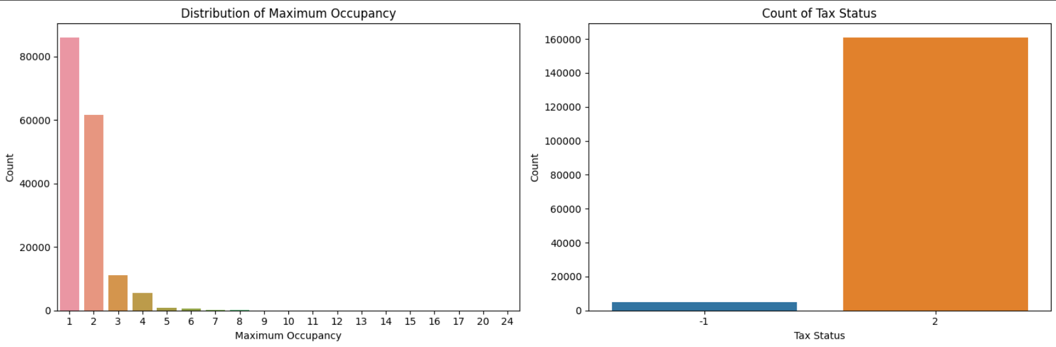
EDA

Slide 15
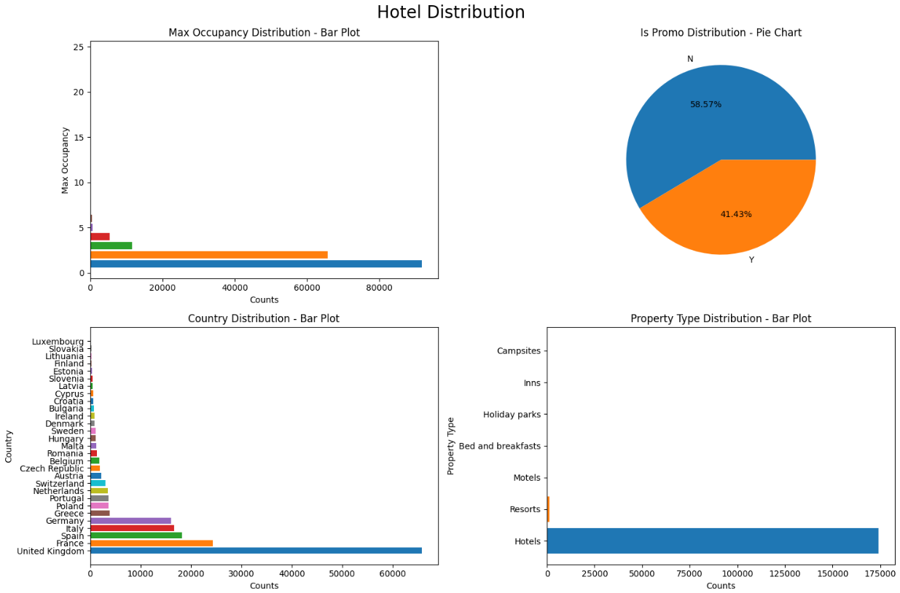
EDA

Slide 16
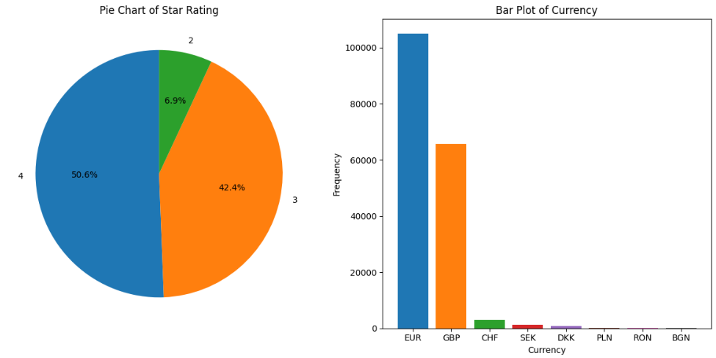
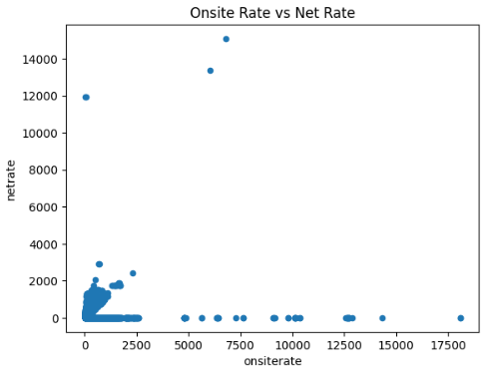
EDA

Slide 17

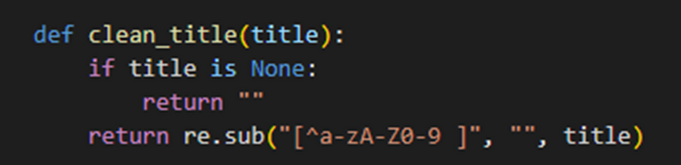
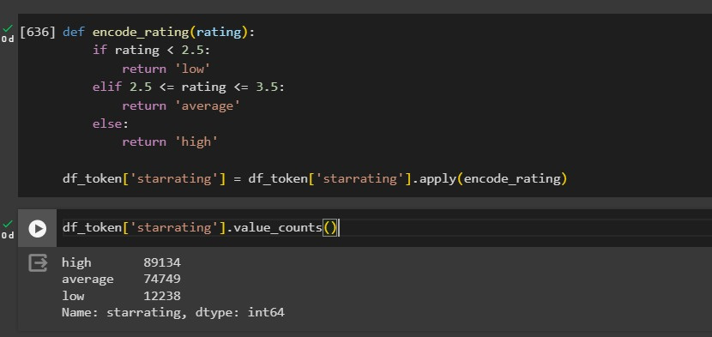
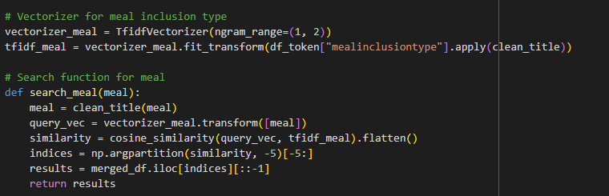
Feature Engineering
TF-IDF

Slide 18
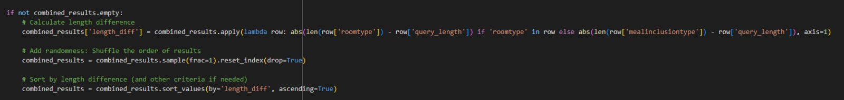
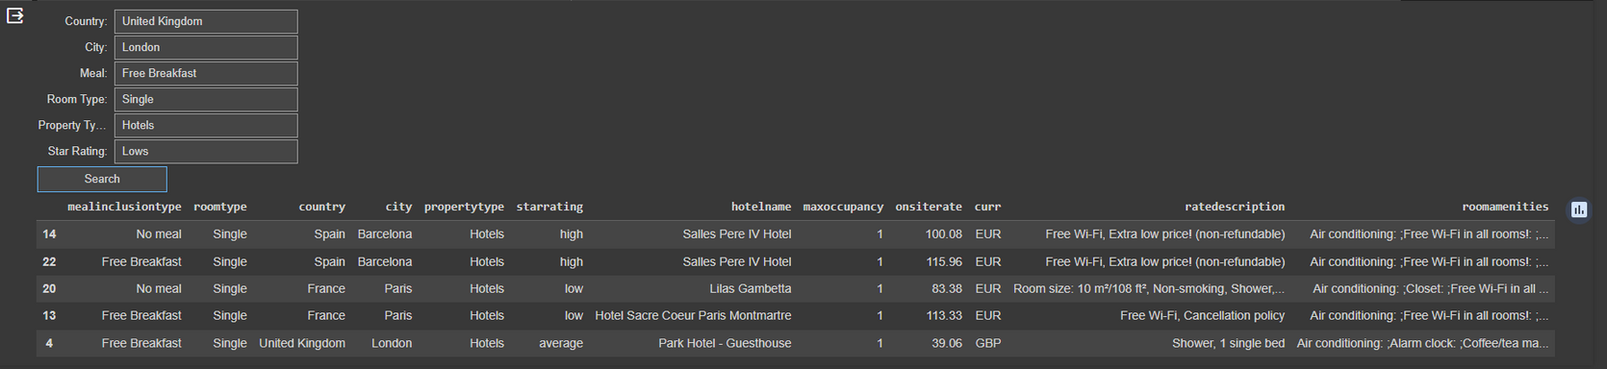
MODELLING

Slide 19
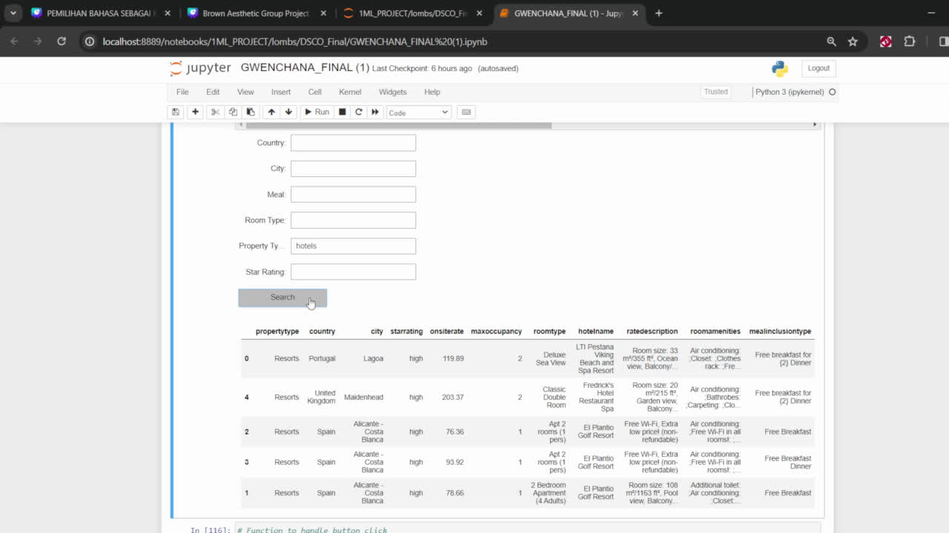
DEMO

Slide 20
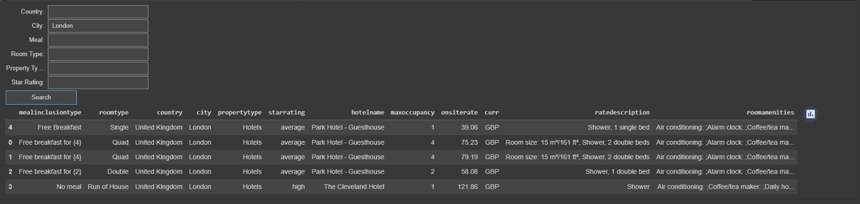
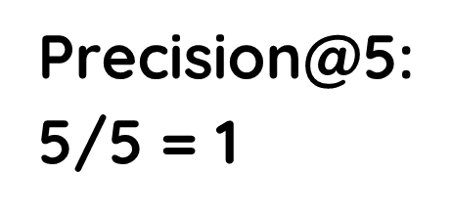
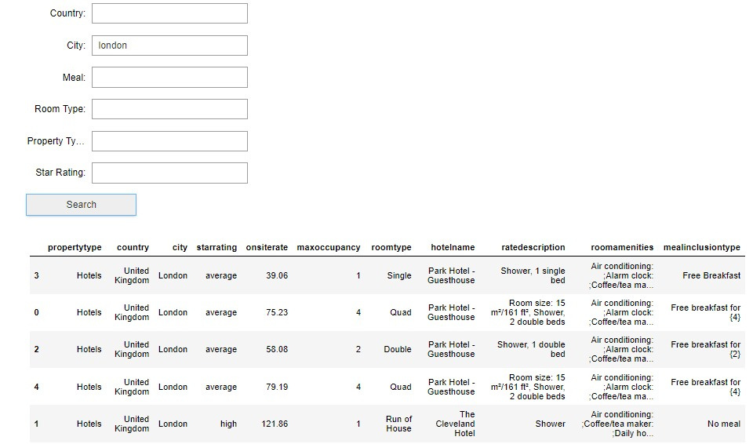
Prediction Result

Slide 21
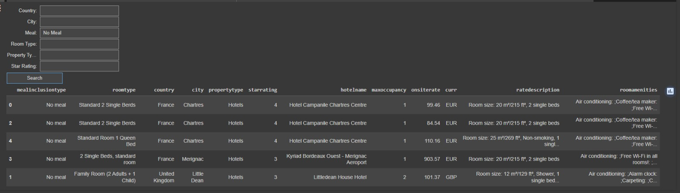
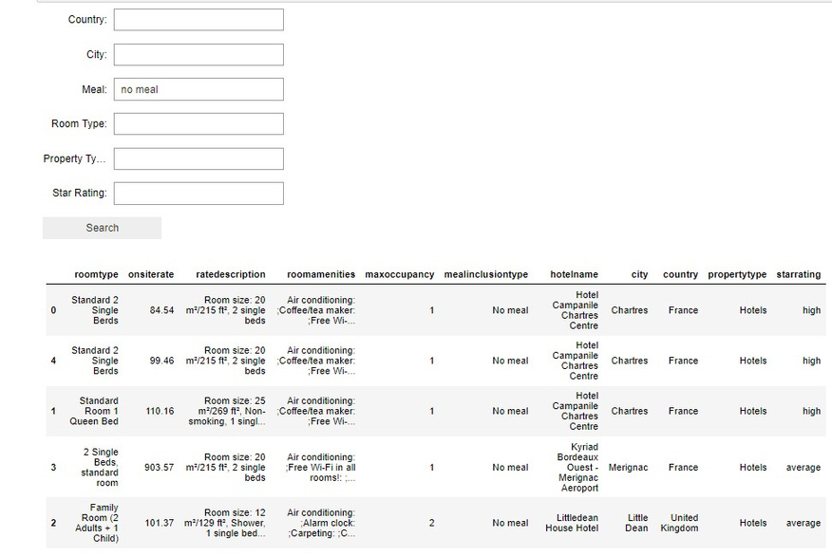
Prediction Result
Precision@5:
5/5 = 1
Precision@5:
5/5 = 1

Slide 22
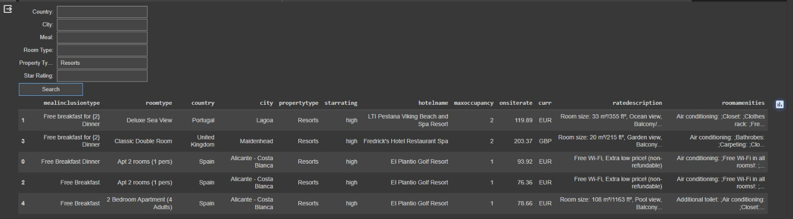
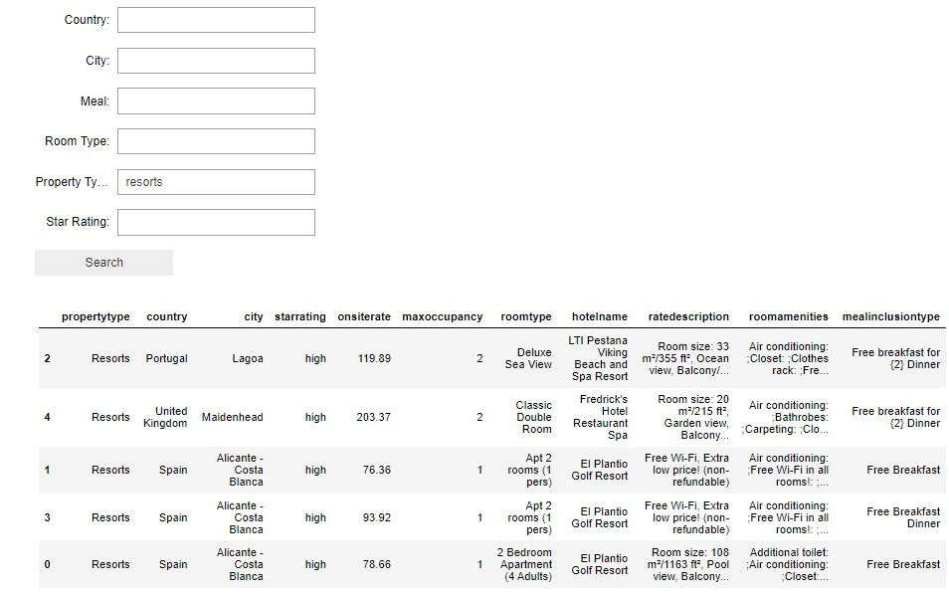
Prediction Result
Precision@5:
5/5 = 1
Precision@5:
5/5 = 1

Slide 23
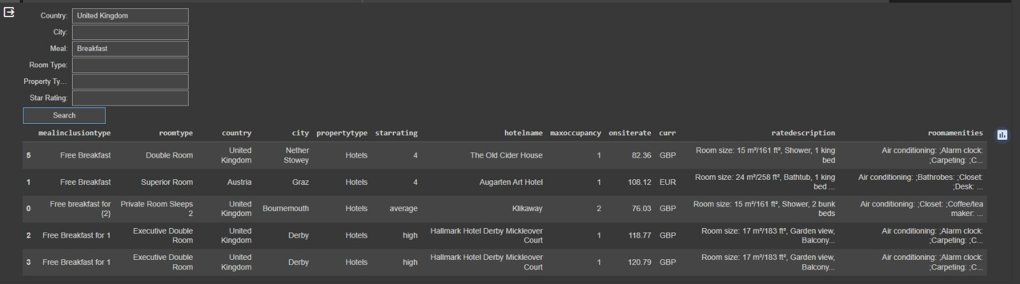
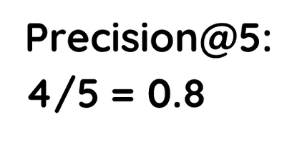
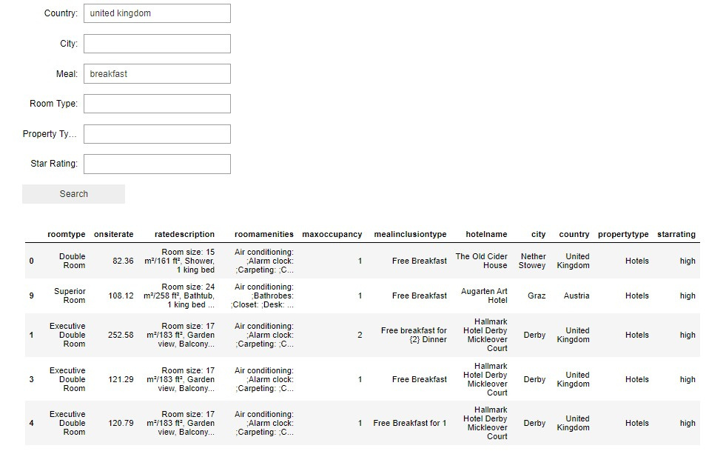
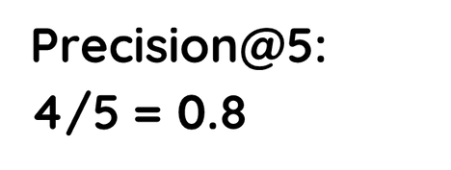
Prediction Result

Slide 24
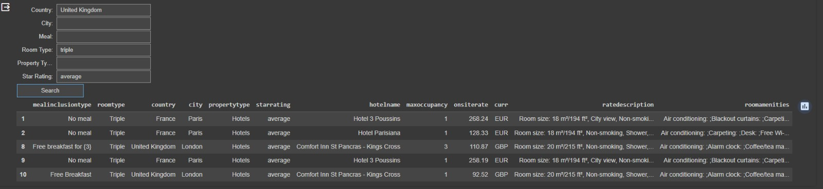
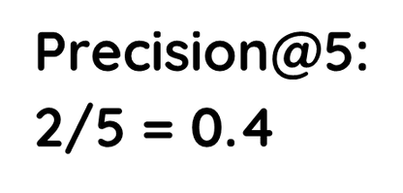
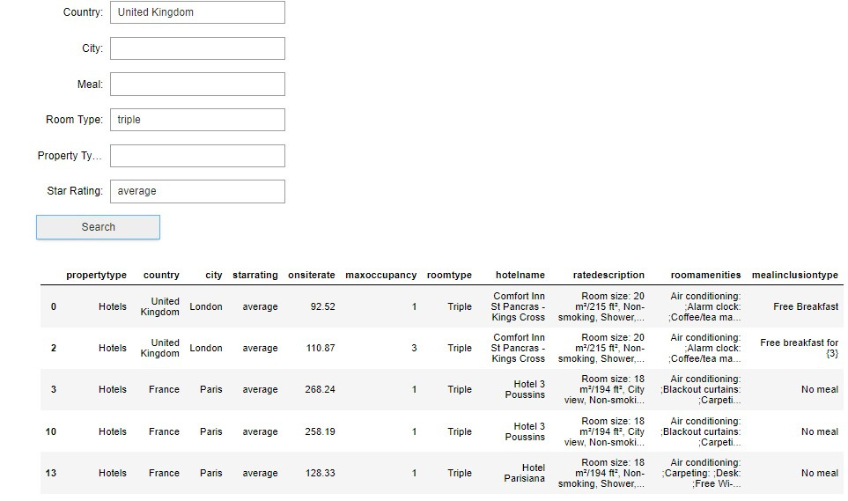
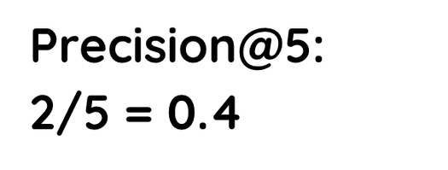
Prediction Result

Slide 25
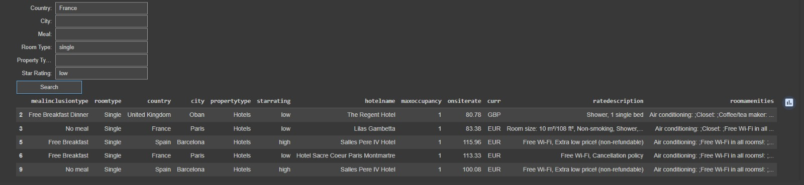



Prediction Result

Slide 26




Prediction Result

Slide 27


Prediction Result
Precision@5:
0/5 = 0
Precision@5:
0/5 = 0

Slide 28

Conclusion
Thankyou

